Slide 1
UTM@Cal Meeting
Hybrid Systems Laboratory
March 4, 2016

Slide 2
Overview of current work
Performance guarantees under varying degrees of structure
Platooning
Sequential path planning
Unstructured collision avoidance
Theory
Basic reachability
Time-varying formulation
Mixed implicit explicit formulation
Decoupled formulation
Work in progress

Slide 3
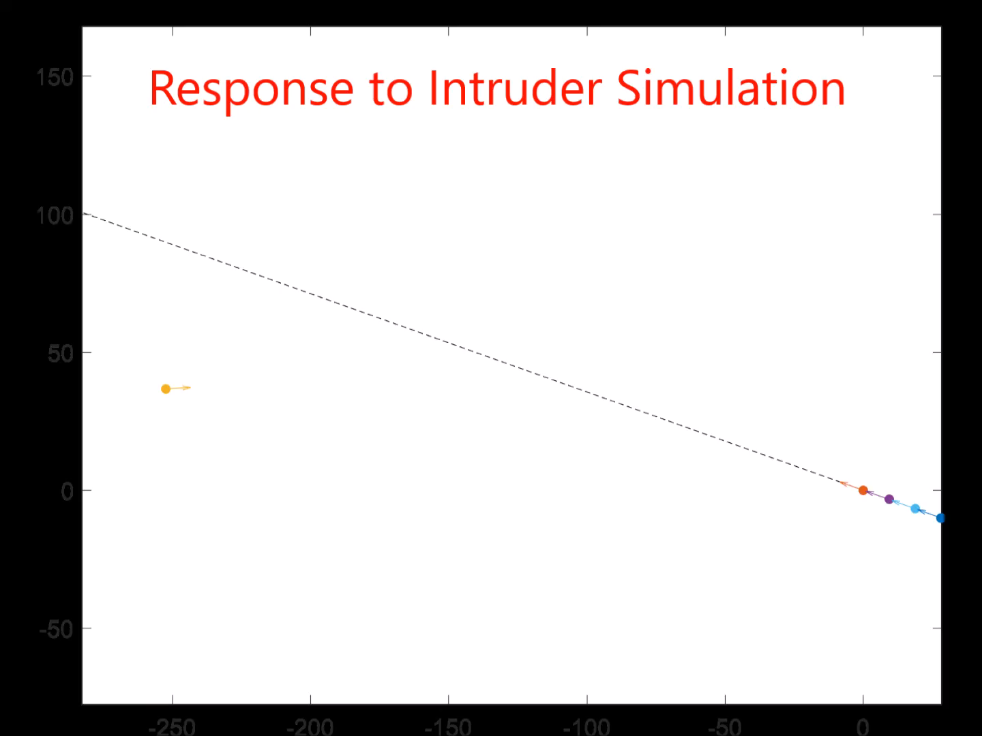
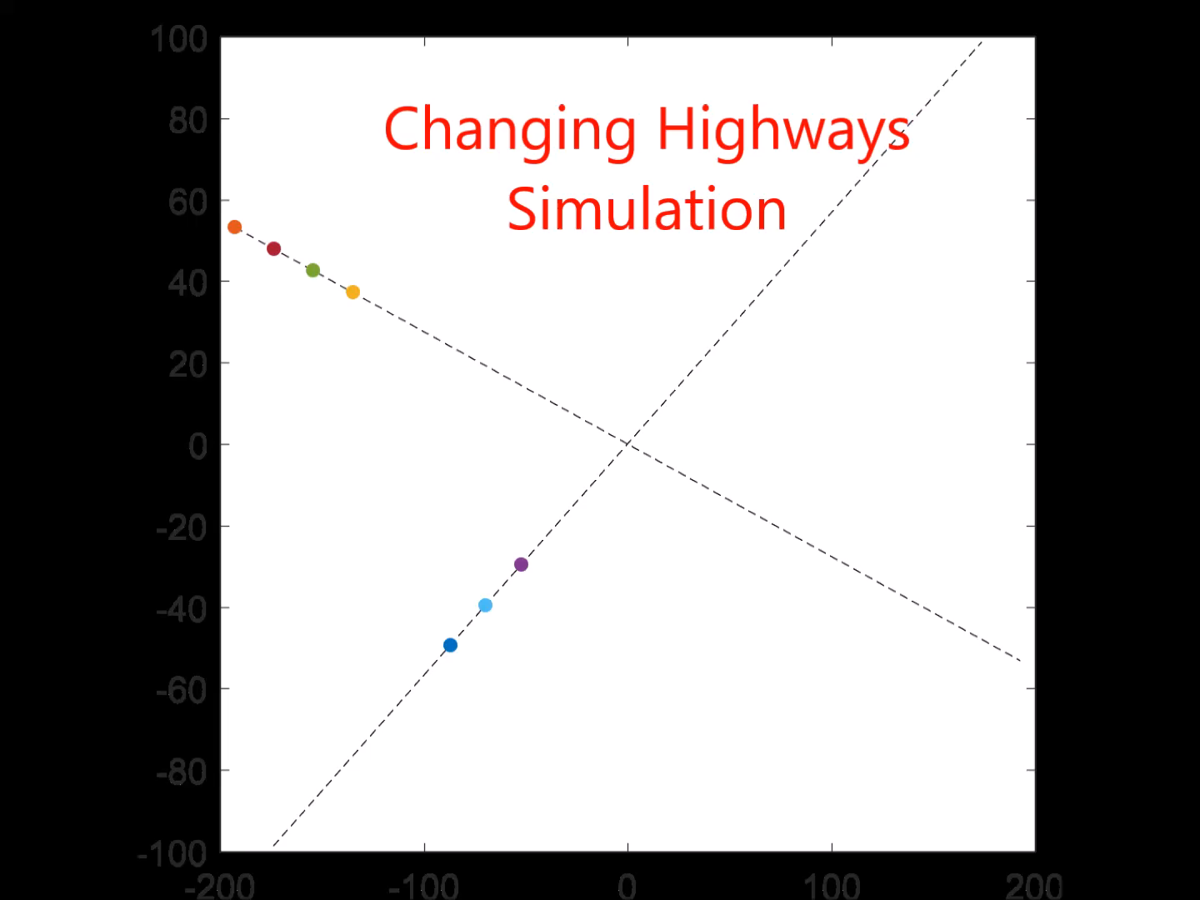
Platooning

Slide 4
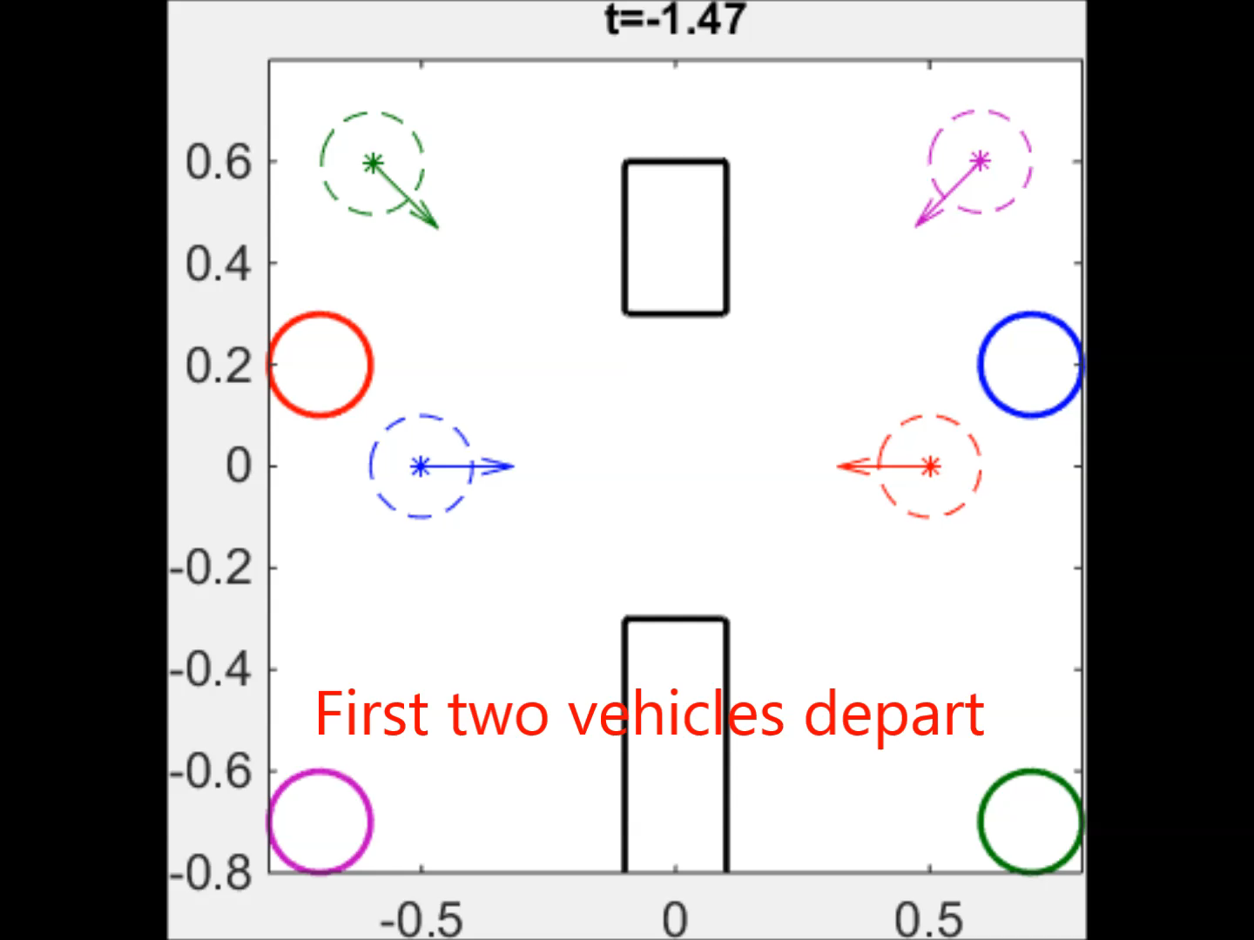
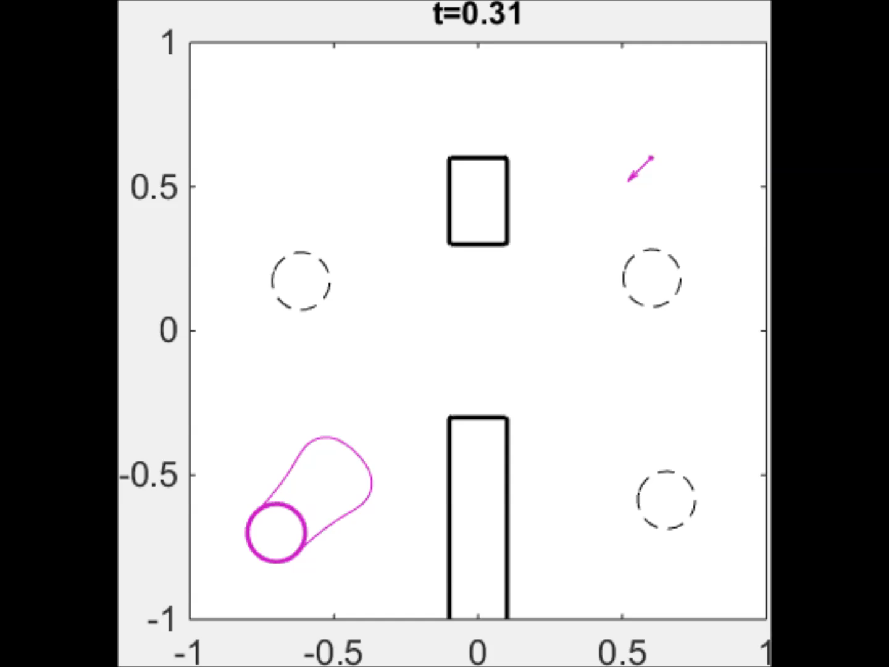
Sequential Path Planning

Slide 5
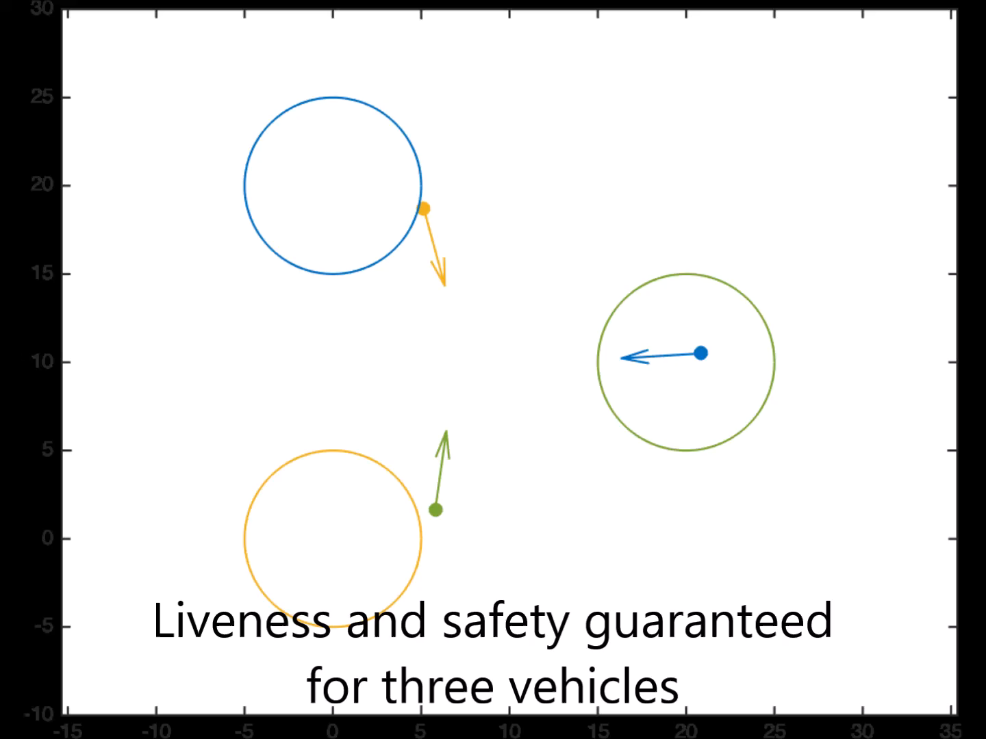
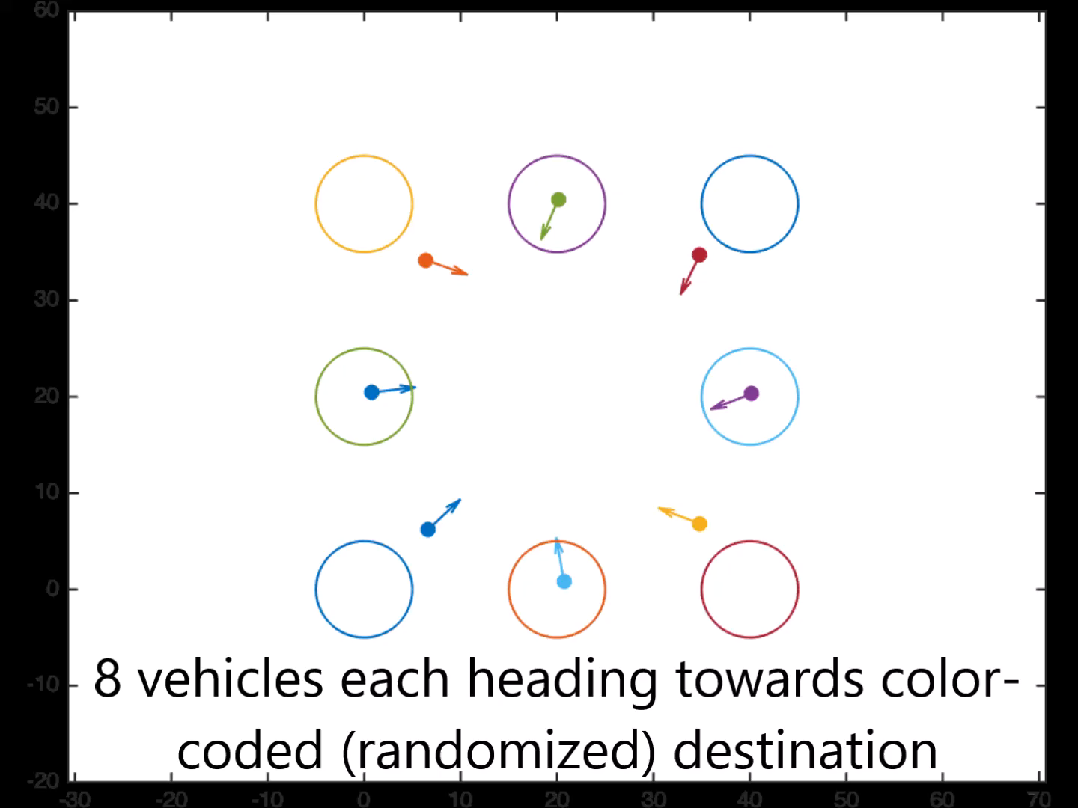
Unstructured Collision Avoidance

Slide 6
Theory
Nonlinear dynamics
Nonconvex goal and constraint sets
Main concern: problem dimensionality
Full solution intractable for systems higher than 5D

Slide 7
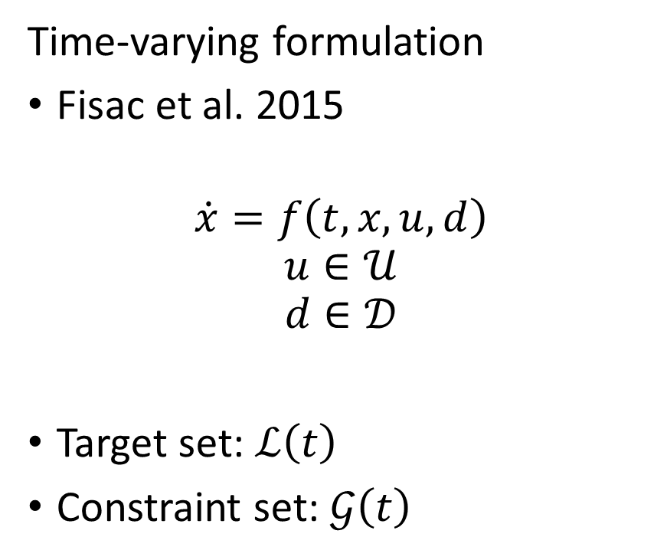
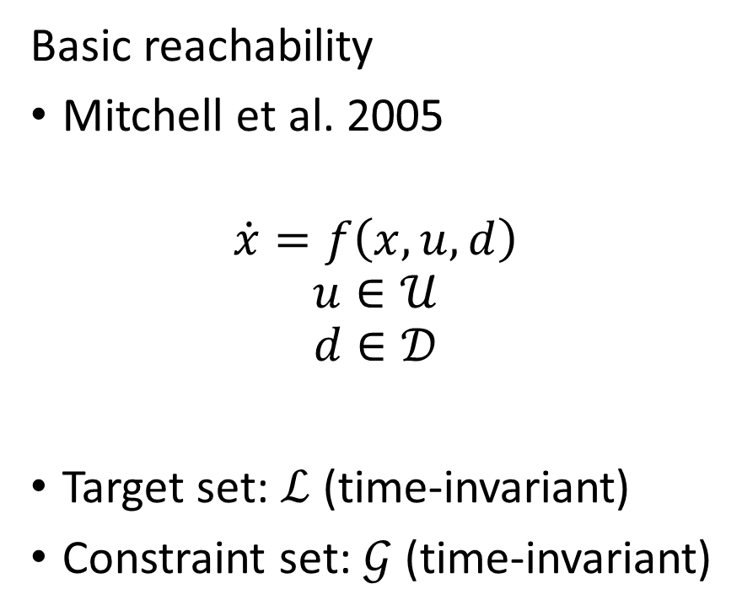
Full formulations
Basic reachability
Mitchell et al. 2005
$$\dot{x}=f\left(x,u,d\right)$$
$$u∈𝒰$$
$$d∈𝒟$$
Target set: $ℒ$ (time-invariant)
Constraint set: $𝒢$ (time-invariant)
Time-varying formulation
Fisac et al. 2015
$$\dot{x}=f\left(t,x,u,d\right)$$
$$u∈𝒰$$
$$d∈𝒟$$
Target set: $ℒ\left(t\right)$
Constraint set: $𝒢\left(t\right)$

Slide 8
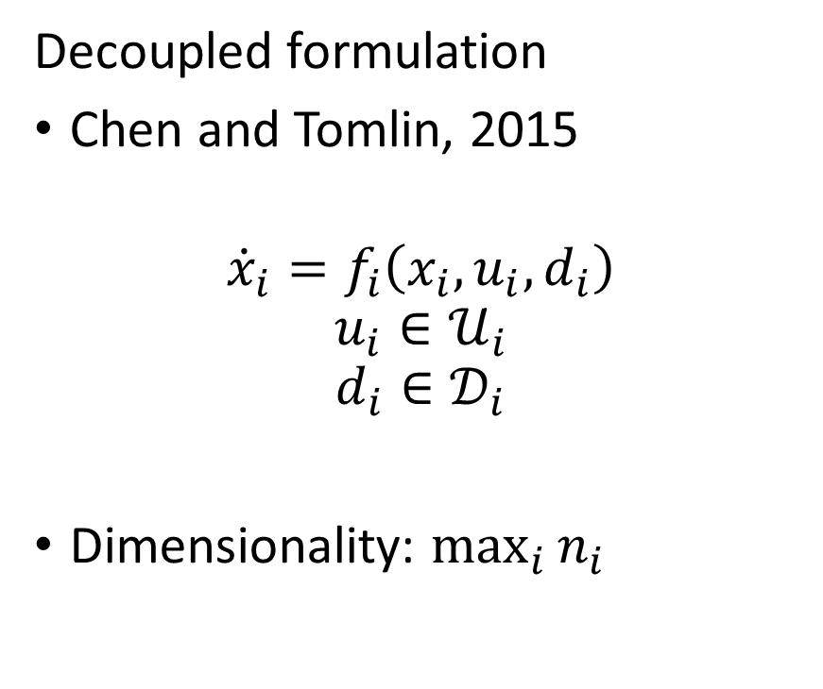
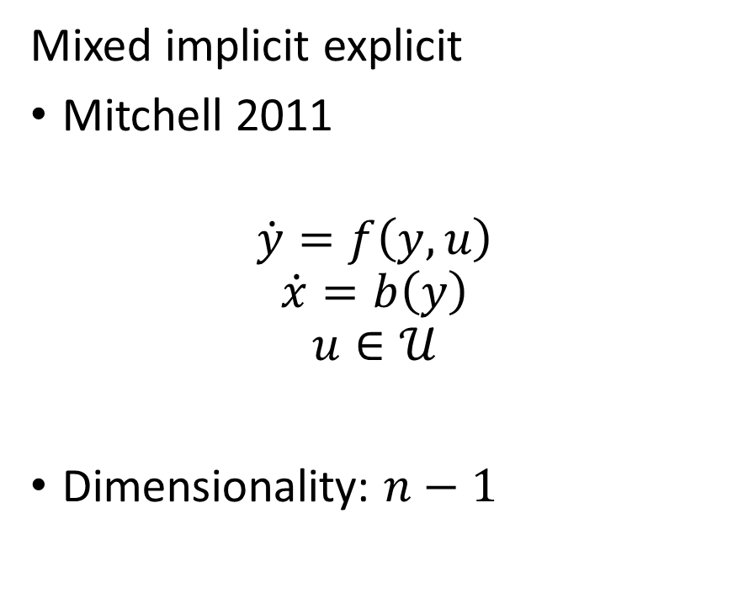
Lower dimensional exact formulations
Mixed implicit explicit
Mitchell 2011
$$\dot{y}=f\left(y,u\right)$$
$$\dot{x}=b\left(y\right)$$
$$u∈𝒰$$
Dimensionality: $n−1$
Decoupled formulation
Chen and Tomlin, 2015
$${\dot{x}}_{i}=f_{i}\left(x_{i},u_{i},d_{i}\right)$$
$$u_{i}∈𝒰_{i}$$
$$d_{i}∈𝒟_{i}$$
Dimensionality: $\max_{i}{n_{i}}$

Slide 9
Work in progress
Applications
Theory
Platooning
Practical implementation
(many problems)
Sequential path planning
Disturbance handling [CDC16]
Intruder avoidance
Unstructured collision avoidance [CDC16]
Safety guarantees for more vehicles
(many problems)
Fast computation for more general dynamics
Decoupling systems [CDC16]
Approximations
Partial solutions

